Slide 1
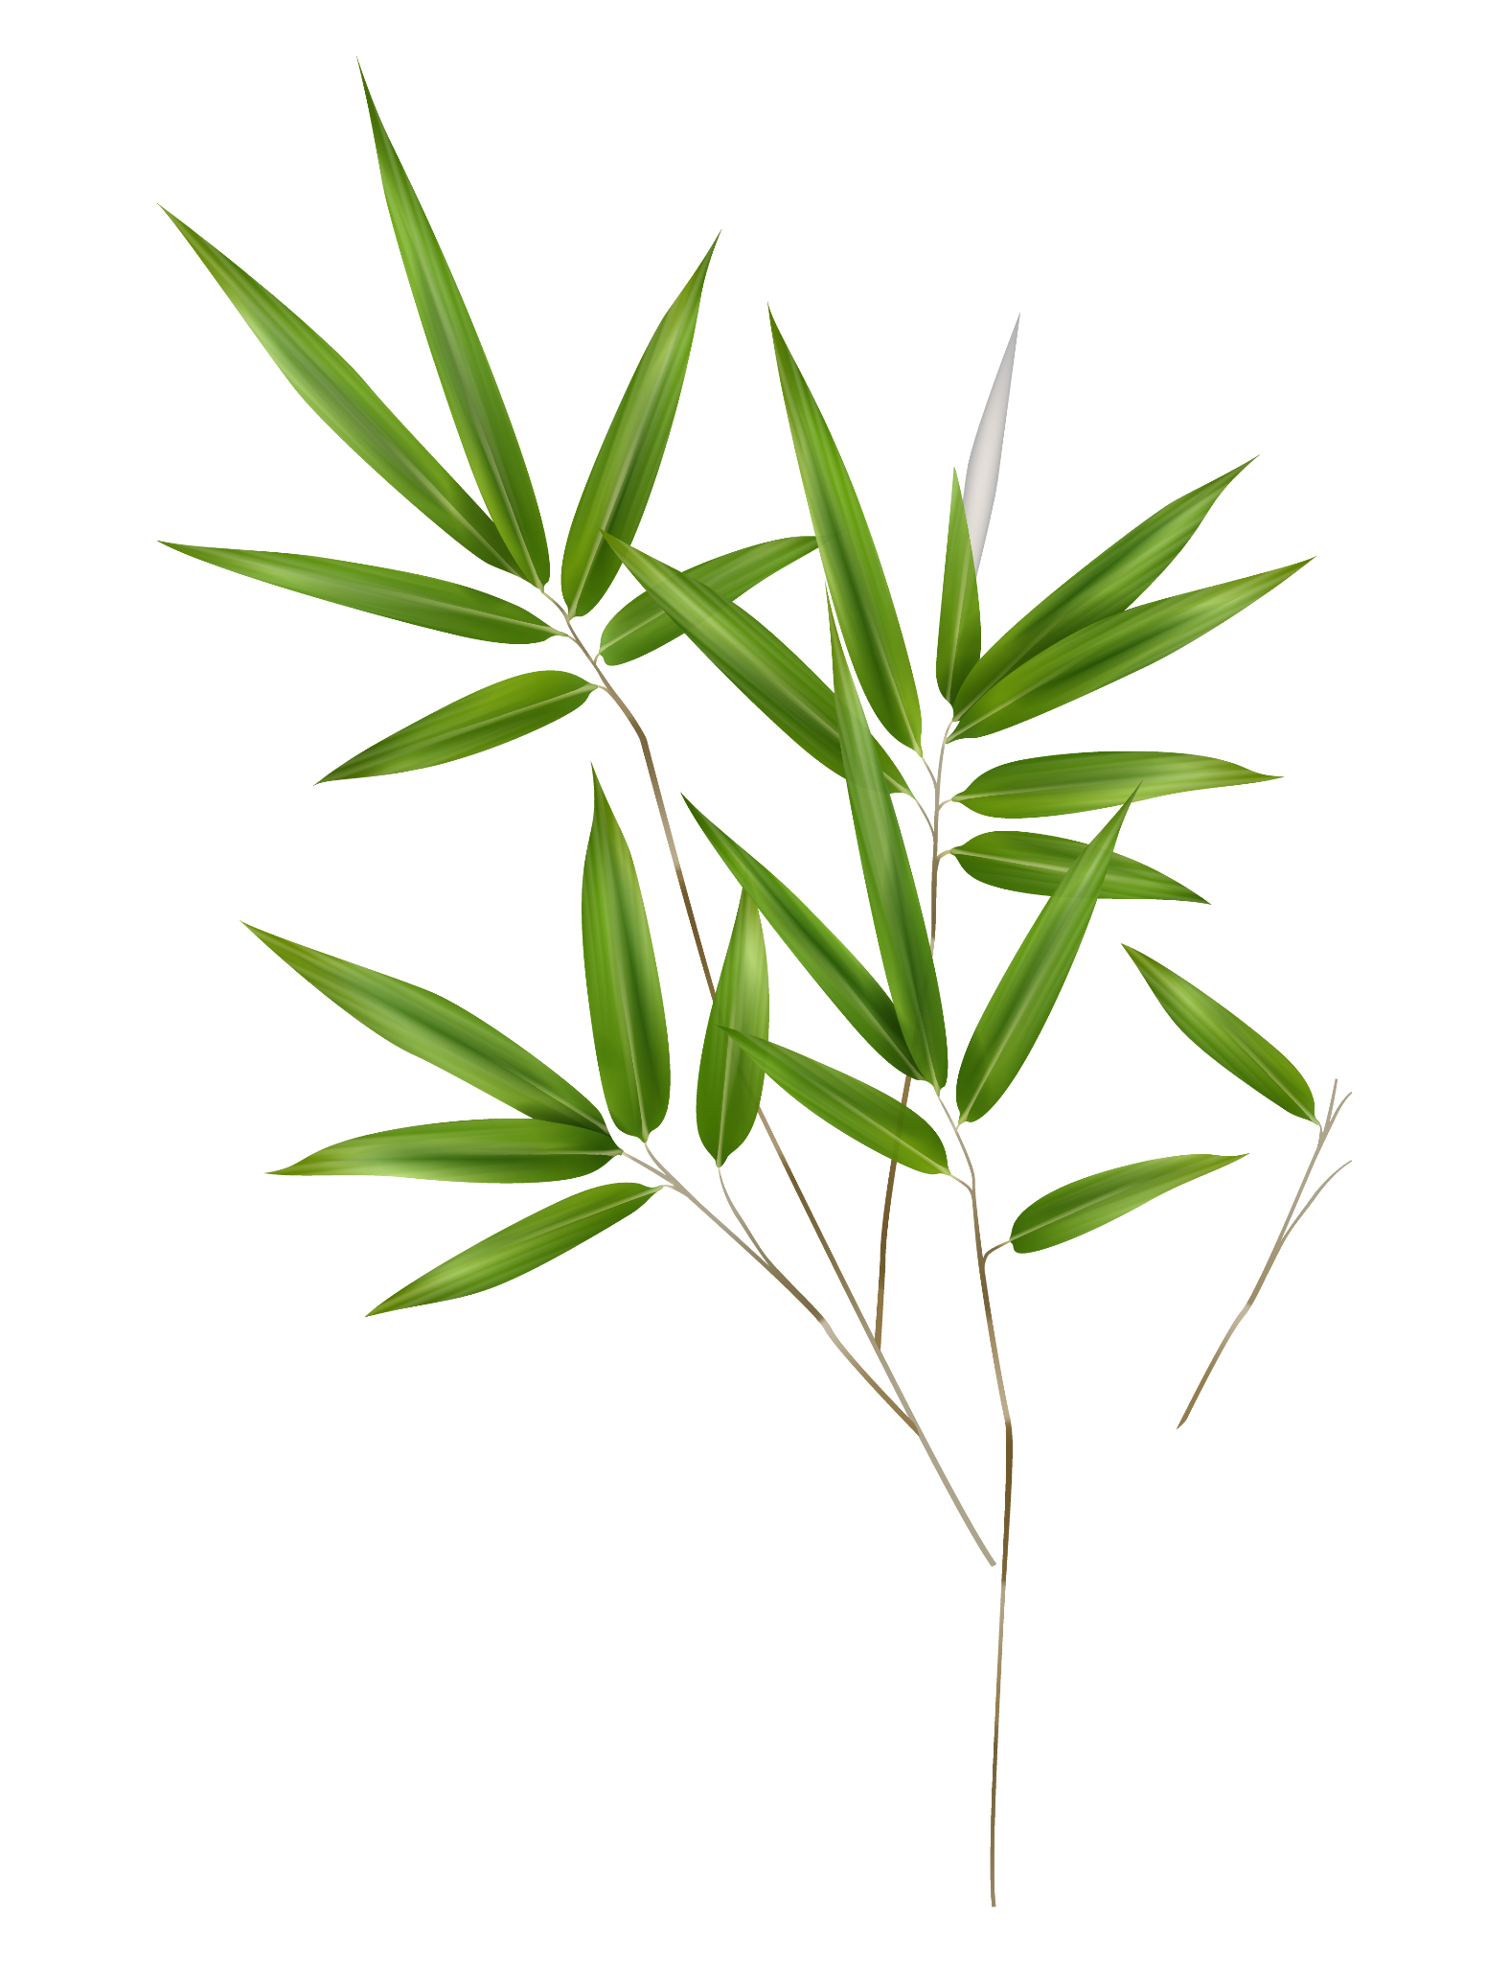
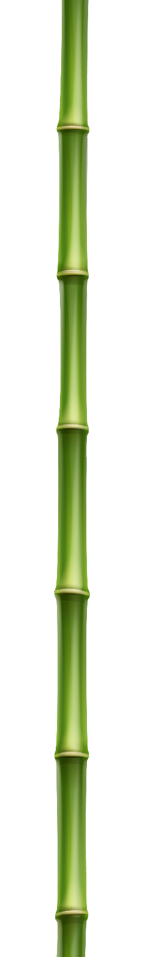
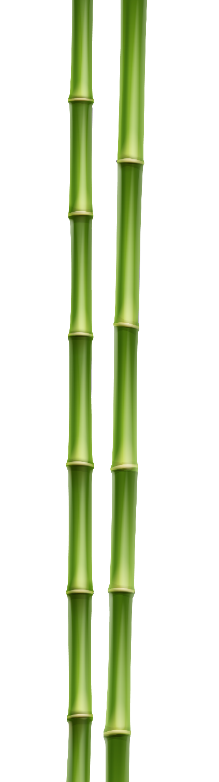

O An Quan Game
Nguyen Trung Kien – 20226052
Ha Minh Duc – 20226027
Phung Duc Dat - 20226025

Slide 2
Table of contents
01
02
03
04
Introduction
Product Analysis and Design
OOP Techniques
Product Demo

Slide 3
01
Introduction

Slide 4
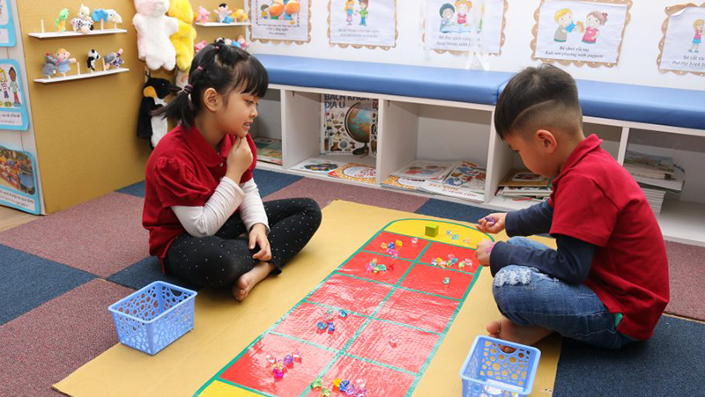
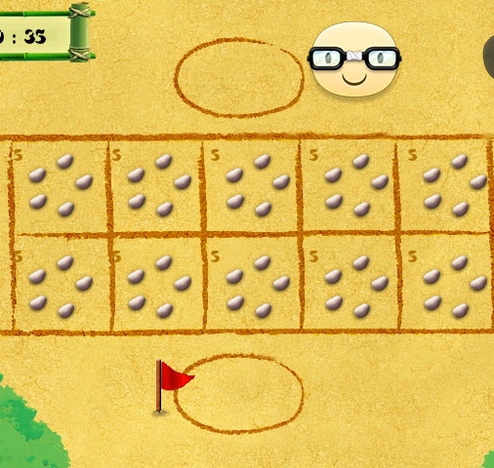
Problem
Popular traditional Vietnamese game, especially among youth with simple rules, strategic gameplay
Digital versions exist on various platforms, but lack user-friendly experience

Slide 5

Target
The O An Quan app is a lightweight, customizable way to experience the traditional Vietnamese game with friends and family on one device. Its authentic interface and music aim to preserve cultural heritage while providing a fun and engaging multiplayer experience.

Slide 6
Rules of game
1. Start:
Players play rock-paper-scissors to determine who goes first.
The first player chooses any square on their side of the board and takes all the pieces from that square.
2. Sowing:
Sow the pieces one by one, placing one piece in each square, moving in one direction (left or right).
When all pieces are sown, take the pieces from the next square and continue sowing.
3. Capturing:
If you land on an empty square, capture all the pieces in the square immediately after it.
If the square after the captured square is also empty, continue capturing pieces in the following squares.
Capturing pieces in the Mandarin Square follows the same rules.

Slide 7
Rules of game
4. Passing (Losing a Turn):
If you sow into the Mandarin Square (whether it has pieces or not).
If you sow into two consecutive empty squares.
5. Running Out of Pieces on Your Side (Borrowing):
Use 5 captured pieces to place one piece in each square on your side before starting your turn.
If you don't have enough pieces, borrow from your opponent and return them when counting points at the end of the game.
6. Ending & Winning:
Capture all the pieces on the board.
Or capture both Mandarin pieces; the remaining pieces belong to the player on whose side of the board those pieces are.
The player with more pieces wins the game!

Slide 8
02
Product Analysis and Design

Slide 9
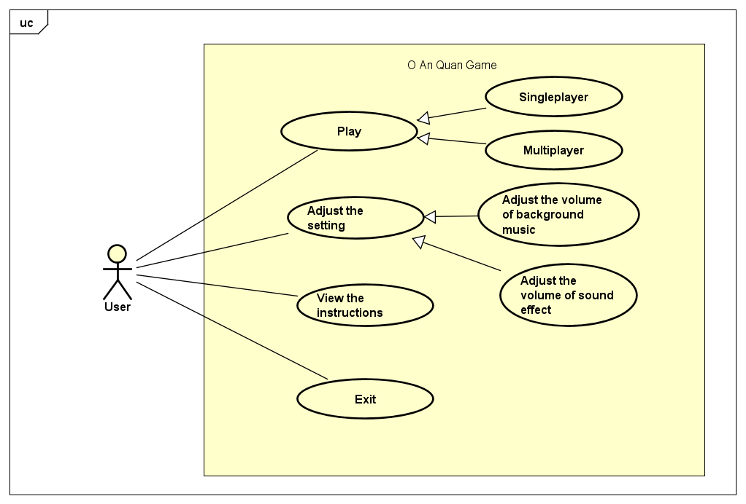
Use case Diagram
Use Cases:
- Play: Initiates the game. The user can choose between two options:
Singleplayer: Play against the computer.
Multiplayer: Play against another human player.
- Adjust the setting: Allows the user to customize game settings, including:
Adjust the volume of background music: Change the background music level.
Adjust the volume of sound effect: Change the sound effects level.
- View the instructions: Displays the rules and guidelines of how to play the game.
- Exit: Closes the application.

Slide 10
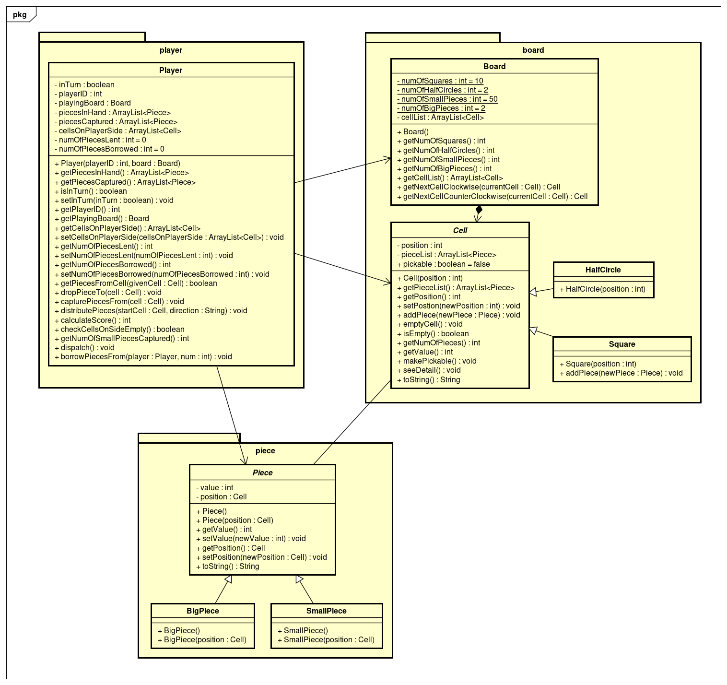
Class Diagram
Player: Has an ID, associated board, pieces in hand/captured, controlled cells, and actions like dropping/capturing pieces, calculating scores, and borrowing pieces.
Board: Contains squares, half-circles, small/big pieces, a list of cells, and methods to retrieve cell information.
Cell: Basic unit on the board with a position, a list of pieces, and subclasses for square and half-circle cells.
Piece: Has a value, position, and subclasses for big and small pieces.

Slide 11
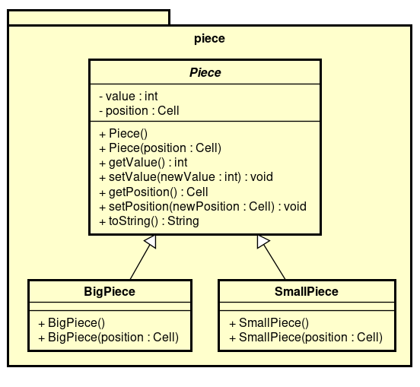
Class Diagram
Class Piece
Attributes:
value (int): Numerical value of the piece.
position (Cell): Current position on the board.
Methods:
Piece(): Default constructor.
Piece(position: Cell): Constructor with initial position.
Getters and setters for value and position.
toString(): Returns a string representation of the piece.
Classes BigPiece and SmallPiece
Inherit from Piece.
Represent different types of chess pieces (e.g., Pawn, Rook, Queen, King).
Constructors corresponding to the parent class.

Slide 12
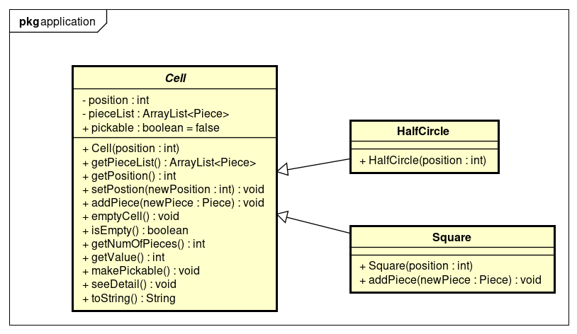
Class Diagram
Key Points:
Cell is the base class, providing attributes like position, pieceList, and pickable, along with methods for managing pieces and cell properties.
HalfCircle and Square inherit from Cell, representing different cell types on the game board.
The diagram lacks details about the Piece class and the specific game rules.
The seeDetail() method is not implemented, leaving its purpose unclear.
Possible Game Mechanics:
Players might move pieces between cells.
The pickable flag could indicate selectable cells during a player's turn.
getValue() might calculate the total value of pieces on a cell, potentially relevant for scoring or game logic.

Slide 13
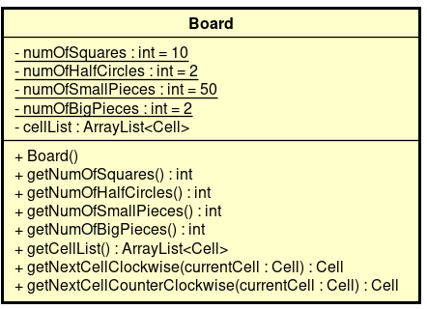
The Board class represents a game board with a fixed layout of 10 square cells and 2 half-circle cells. It also keeps track of 50 small game pieces and 2 big game pieces. The board is organized as a list of cells (cellList).
Key methods:
getNextCellClockwise(currentCell: Cell): Returns the next cell in the clockwise direction from the given cell.
getNextCellCounterClockwise(currentCell: Cell): Returns the next cell in the counter-clockwise direction from the given cell.

Slide 14
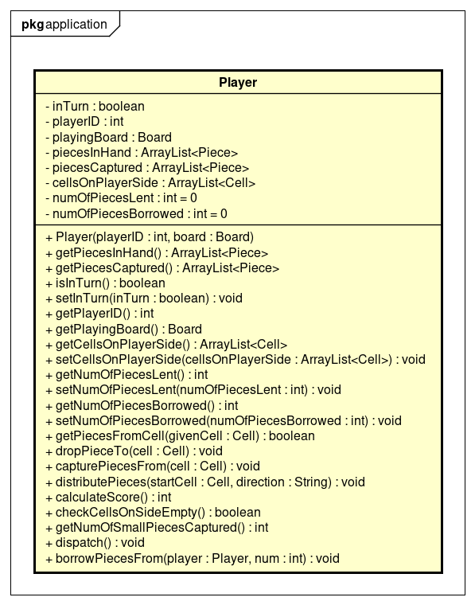
Game State:
inTurn: Indicates if it's the player's turn.
playerID: A unique identifier for the player.
playingBoard: The game board the player is interacting with.
Pieces:
piecesInHand: Pieces the player currently holds.
piecesCaptured: Pieces the player has captured.
numOfPiecesLent, numOfPiecesBorrowed: Tracking of lent/borrowed pieces.
Board Interaction:
cellsOnPlayerSide: Cells on the board belonging to the player.
Key Methods:
Game Actions:
getPiecesFromCell: Retrieve pieces from a cell.
dropPieceTo: Place a piece on a cell.
capturePiecesFrom: Capture pieces from a cell.
distributePieces: Distribute pieces on the board.
Game State Evaluation:
calculateScore: Calculate the player's score.
checkCellsOnSideEmpty: Check if the player's side of the board is empty.
Other Actions:
dispatch: Perform a game action (not detailed in the diagram).
borrowPiecesFrom: Borrow pieces from another player.

Slide 15
03
OOP TECHNIQUES

Slide 16
OOP TECHNIQUES - AGGREGATION - ASSOCIATION-COMPOSITION
Aggregation:
Player - PiecesInHand, PiecesCaptured, CellsOnPlayerSide
Board - CellList
Cell - PieceList
Association:
Player - PlayingBoard
Piece - Position
Composition:
Board - Square, HalfCircle
Piece - BigPiece, SmallPiece

Slide 17
OOP TECHNIQUES - INHERITANCE
Cell is the parent class of Square and HalfCircle: Both Square and HalfCircle inherit from Cell, meaning they have all the attributes and methods of Cell (like position, pieceList, getPieceList, addPiece, removePiece), and can have additional attributes and methods of their own.
Piece is the parent class of BigPiece and SmallPiece: Similarly, BigPiece and SmallPiece inherit from Piece, sharing common attributes and methods (like value, position, getPosition), and can have their own unique characteristics.

Slide 18
OOP TECHNIQUES - POLYMORPHISM
The bigGem and smallGem can be both called as an object of the Gem class, but has different value of the VALUE attribute.
Only the Square is “pickable”. When looping through the cells (Cell objects) in a board, depending on the type (Square or HalfCircle), the program will decide if the player can pick up gems from that cell or not.
In the isPaneEmpty method of the class GamePlayScreenController, the children of the Pane is retrieved via the built-in method getChildren, in which only the Label objects can implement the getText method.
toString() method is overridden in the bigGem and smallGem."

Slide 19
04
DEMO

Slide 21
Nguyen Trung Kien – 20226052 (Leader) (34%):
Frontend Development: Collaborate on UI design and implementation, focusing on complex components or performance optimization.
Backend Development: Collaborate on game logic implementation, particularly complex algorithms or special case handling.
Project Leadership: Coordinate tasks, manage timelines, facilitate communication, and ensure the project's overall success.
Quality Assurance: Thoroughly test the game to identify and fix any bugs or issues.
Phung Duc Dat – 20226025 (33%):
Frontend Development: Design and implement the JavaFX UI, including the game board, pieces, buttons, score display, and any interactive elements.
UI Enhancements: Collaborate on creating animations and visual effects to make the game more engaging and visually appealing.
Presentation: Design and create the presentation slides showcasing the project and its features.
Ha Minh Duc – 20226027 (33%):
Backend Development: Implement the game logic, including rules, scoring, turn management, win/loss conditions.
Writing report
UML Diagrams: Create use case diagram and class diagram

Slide 22
Thanks!
Please keep this slide for attribution

